Slide 1
Cognitive Neuroscience
Studying the brain.

Slide 2
Cognitive Neuroscience
Where and how does thinking occur in the brain?

Slide 3
Converging Evidence for Dissociations and Associations
Converging evidence: different types of results that imply the same conclusion, lies at the heart of successful investigations in cognitive psychology.
Many of the methods in cognitive psychology are used to accomplish two general types of goals: Dissociation: to establish that an activity or a variable affects the performance of one task (or aspect of one task) but not of another. Double dissociation: an activity or variable affects one process but not another and a second activity or variable has the reverse properties.
Association: occurs when the effects of an activity or variable on one task are accompanied by effects on another task.
Notes:
The first thing you will notice as we continue is that there are a lot of different meth­ods. No one method is ideal; they all have limitations and potential problems. But— and this is a critical point—they have different limitations and potential problems. (p. 25)

Slide 4
Types of Research
Behavioral
Correlational Brain
Causal Brain

Slide 5
Behavioral Methods
A behavioral method measures directly observable behavior such as the time to respond or the accuracy of a response. Researchers attempt to draw inferences about internal representation and processing from such directly observable responses.

Slide 6
Behavioral
Measure observable behavior
Ceiling effects = too easy
Floor effects = too hard

Slide 7
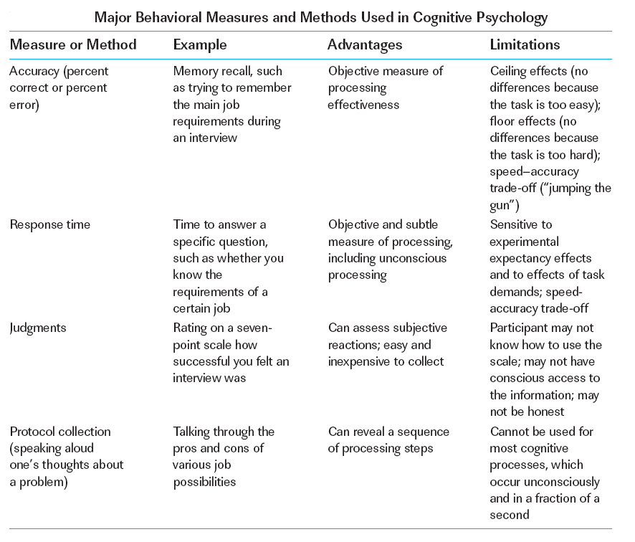

Slide 8
The Ugly of Behavioral
Expectancy effects
Task demands
What’s the brain doing?
Notes:
Go faster once you know what’s goin on
May change responding

Slide 9
Correlational Neural Methods: The Importance of Localization
Cognitive psychology has become extraordinarily exciting during the past decade because researchers have developed relatively inexpensive, high-quality methods for assessing how the human brain functions. These methods are correlational: although they reveal the pattern of brain activity that accompanies information processing, they do not show that activation in specific brain areas actually results in the task’s being carried out. Correlation does not necessarily imply causation.

Slide 10
Err, what’s this chart say?
Spatial resolution
Temporal resolution
Invasive
Cost
Notes:
How small a brain area
How fast it can measure
How much we have to poke people
How much we have to pay

Slide 11
Correlational Neural Methods: The Importance of Localization
We can evaluate the various correlational neural methods on four dimensions: (1) Spatial resolution, how precisely they localize the brain area that produces a signal. (2) Temporal resolution, how precisely they track changes in brain activity over time. (3) Invasiveness, the degree to which they require introduction of foreign substances into the brain. (4) Cost, both for the equipment (and any special facilities) and for its use in each participant test. The three most important neuroimaging.

Slide 12
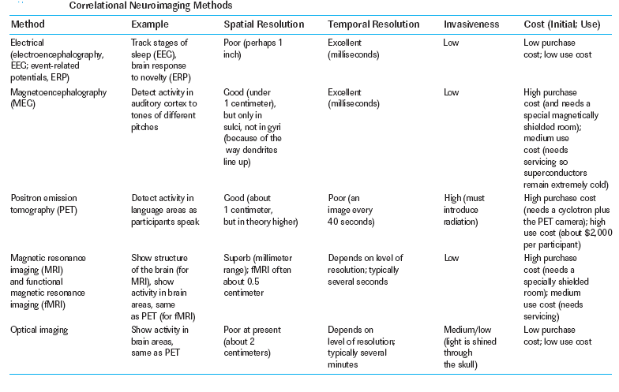
Electricity!

Slide 13
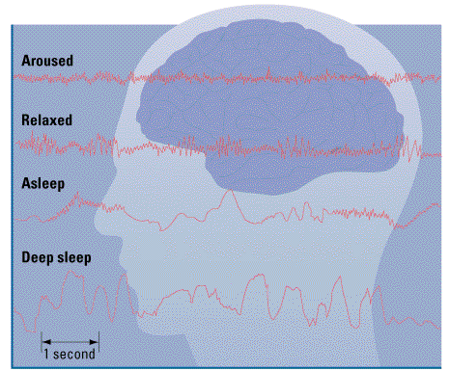
Electroencephalogram
Notes:
Electroencephalography (EEG): Recording activity of (many) surface neurons
measure rapid change in large groups of neurons
Figure 2.8 from:
Kassin, S. (2001). Psychology, third edition. Upper Saddle River, NJ: Prentice Hall.
Source:

Slide 14
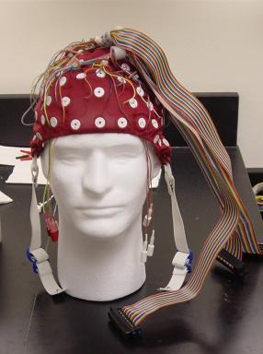
Event Related Potential (ERP)
EEG linked to specific stimuli
Notes:
Event-Related Potential (ERP): Activity change in response to stimuli (derived from EEG)
measure rapid change in large groups of neurons

Slide 15
Electromyography
Response of muscle groups
Face
Notes:
Electromyography: Muscle activity / tension

Slide 16
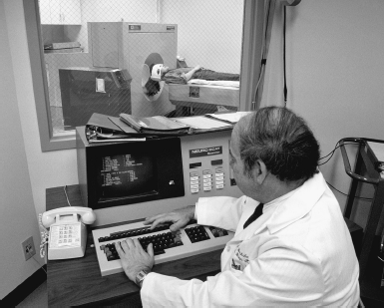
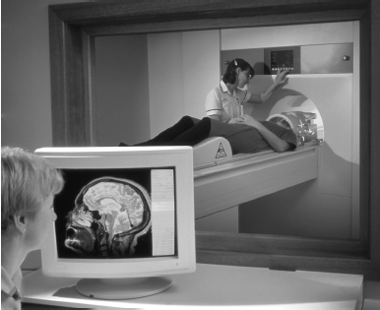
Blood Movin’ Around
A PET scan in progress.
An fMRI scan in progress.

Slide 17
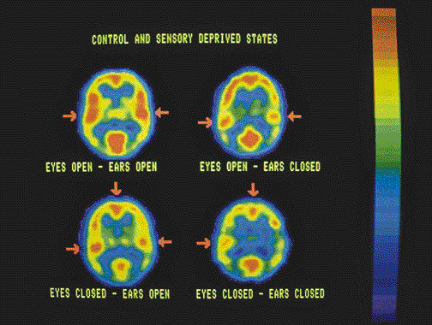
Positron Emission Tomography
Radioactive isotopes
Active areas have increased blood flow
Notes:
Active areas have increased blood flow
Radioactive isotopes (small amounts) are placed in the blood
Sensors detect radioactivity
Different tasks show distinct activity patterns
Figure 2.09 from:
Kassin, S. (1998). Psychology, second edition. Upper Saddle River, NJ: Prentice Hall.

Slide 18
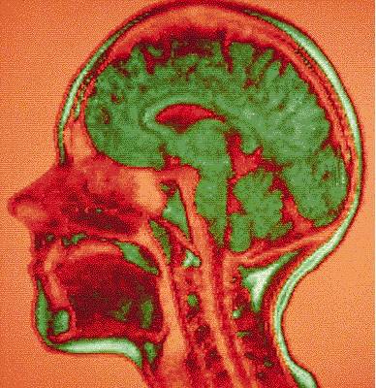
Magnetic Resonance Imaging
Magnetic fields align certain ions and compounds
Notes:
Figure 2.10 from:
Kassin, S. (2001). Psychology, third edition. Upper Saddle River, NJ: Prentice Hall.

Slide 19
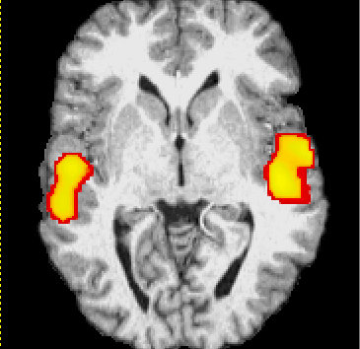
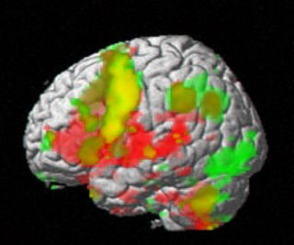
Functional MRI
Multiple MRI scans
Notes:
Least invasive method of watching the brain at work

Slide 20
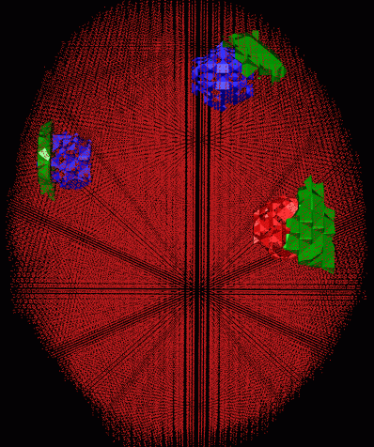
Optical imaging
Diffuse optical tomography - using lasers!
Light is reflected at different rates, so you can track thinking

Slide 21
Cons of Correlation
Positive or negative activation?
More doesn’t equal more
People are different
Brain always thinking
Notes:
More activation doesn’t equal more thinking
So how do you take out that thinking?

Slide 22
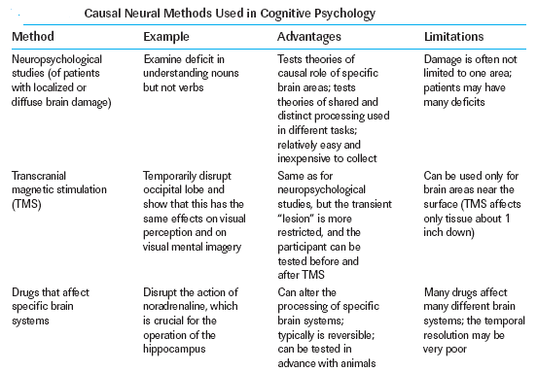
The Causal Brain
Notes:
Researchers have depended on other types of studies to establish causal connections between brain activation and performance. Such methods, summarized in Table 1–3, show that activity in a particular brain area actually gives rise to specific representa­tions or carries out specific processes. (p. 37)

Slide 23
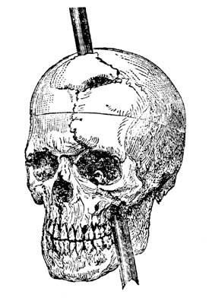
Lesions: The Case of Phineas Gage
Gage was a railroad construction foreman
An 1848 explosion forced a steel tamping rod through his head
Others said he was “…no longer Gage…”
Lost his job, worked as a sideshow exhibit
Notes:
Figure 2.2 from:
Kassin, S. (1998). Psychology, second edition. Upper Saddle River, NJ: Prentice Hall.
Source: Damasio, et al., 1994

Slide 24
Modeling
Computer simulation models: intended to mimic the underlying mental representations and processes that produce specific types of human performance. Computer simulations must be distinguished from programs in artificial intelligence, which are intended to produce “intelligent” behavior but may incorporate underlying processes far different from those used by humans.
Process models: specify a sequence of processes that convert an input to an output. Such models can be illustrated with a flowchart, and are sometimes called “box and arrow” models.
Notes:
Mental activity also can be studied by constructing models. Models can not only tell you whether a set of principles or mechanisms can in fact explain data, but they can also make new predictions. What’s the difference between a theory and a model? A theory proposes a set of abstract principles that can account for a range of phenom­ena; a model is a specific, concrete version of a theory. (p. 40)

Slide 25
Neural-Network Models
Neural-network models: rely on sets of interconnected units, each of which is intended to correspond to a neuron or a small group of neurons. Units are not the same thing as neurons, but rather they specify the input–output process a neuron or group of neurons performs.
The simplest models include three layers of units: (1) The input layer is a set of units that receives stimulation from the external environment. (2) The units in the input layer are connected to units in a hidden layer, so named because these units have no direct contact with the environment. (3) The units in the hidden layer in turn are connected to those in the output layer.
Notes:
Each connection from an input unit ei­ther excites or inhibits a hidden unit. Furthermore, each connection has a weight, a measure of the strength of its influence on the receiving unit. Some networks include feedback loops, for example, with connections from hidden units to input units. Here is a crucial point: the pattern of weights in the entire network serves to repre­sent associations between input and output. Neural networks not only use parallel processing, they rely on distributed parallel processing, in which a representation is a pattern of weights, not a single weight, node, or connection. (p. 42)

Slide 26
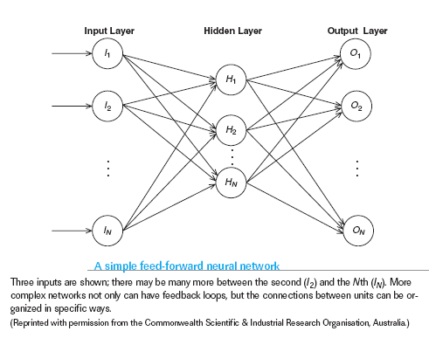
Neural-Network Models

Slide 27
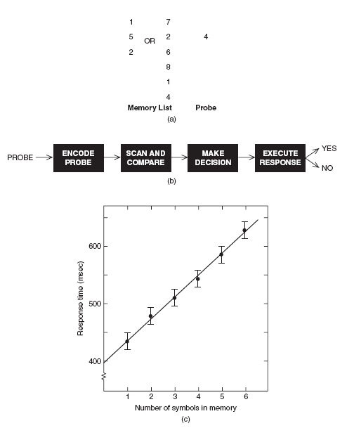
Modeling
Notes:
(a) The first task is to memorize a short list of items—here, numbers. Then a probe item, say, “4,” is
presented that may or may not have been on the list. The task is to decide whether it was or was not.
(b) The probe item is encoded and thus entered into memory. The list stored in memory is scanned
and the probe compared to each item on the list; if the list is scanned an item at a time, then the
longer the list, the more time should be required to scan it. Next, a decision is made about how to respond.
Finally, the actual response is executed, leading the participant to press either the YES or the
NO key. (c) The prediction was confirmed: more time was required to scan longer lists. (p. 41)

Slide 28
OMG my brain’s goin to splode!
Know the difference between the types.
Be able to give an example of the types.
Use the table in your notes!

